Slide 1

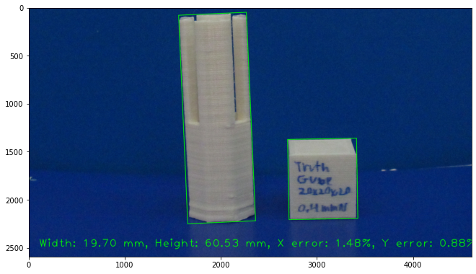
3D Print Quality Estimation
By: Hunter Obendorfer

Slide 2
Why is this necessary?
Starting 3D printing is difficult
Getting a quick estimate on quality can be helpful
Beginners do not know what to look for
Give user’s information

Slide 3

How is this achieved
Estimate
Estimate size
Find
Find burns/blemishes
Find
Find elephant’s foot
Estimate
Estimate quality of these factors
Give
Give the user feedback/solutions

Slide 4
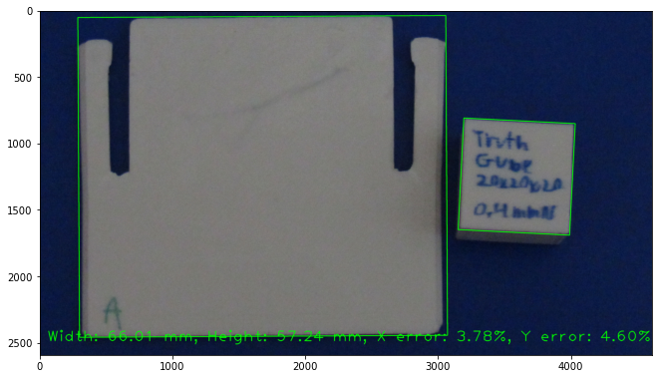
Estimating Size
Done by using an object of known size
Find the bounding box
Calculate the number of pixels
Calculate the error
Nominal Size: 68.6 mm x 60 mm
Measured size: 69.240 mm x 60.325 mm

Slide 5
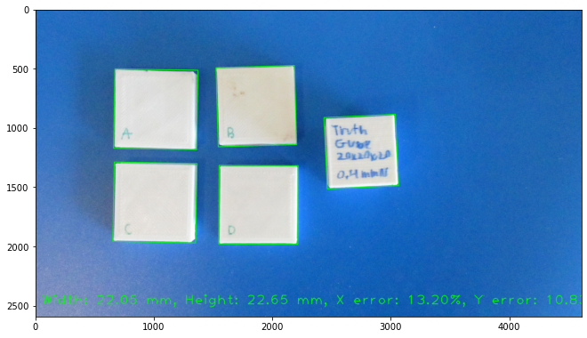
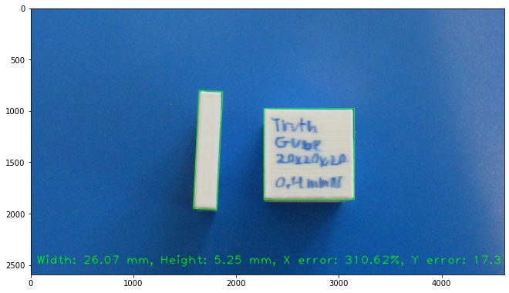
Limitations
The calibration cube position is limited
Higher error in objects of similar size
Orientation can be incorrect
Average actual width: 25.571 mm, Average actual height: 25.387 mm
Incorrect orientation

Slide 6
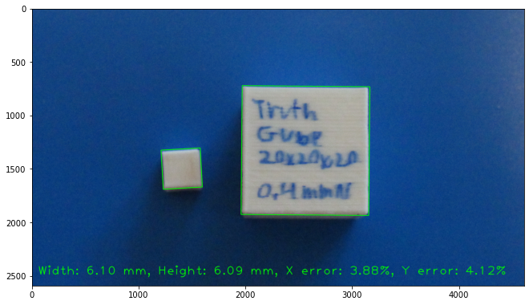
Result
Low error for dissimilar objects, <5%
Will tell user if they need to recalibrate their machine
Links user to a guide.
Nominal: 6.35 mm square
Measured: 6.325 mm x 6.401 mm

Slide 7
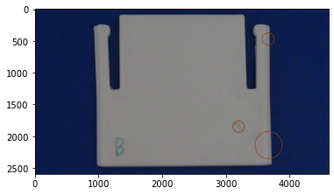
Finding Burns and blemishes
More complex process
First, normalize the grayscale
Second, threshold within a range
Third, find contours of burns/blemishes
Fourth, remove small marks
Fifth, draw circles
Burnt filament showing through on left most circle.

Slide 8
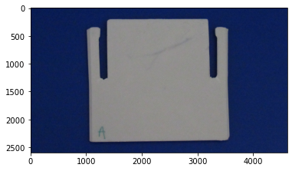
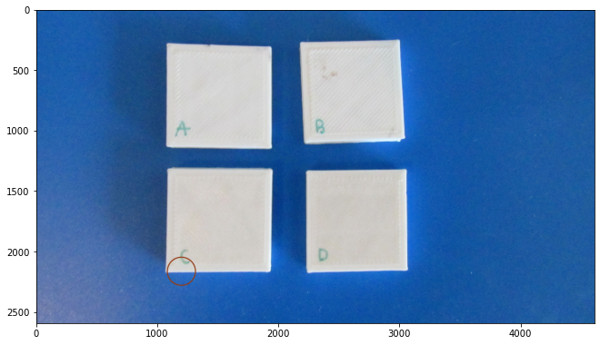
Limitations
Cannot detect long pieces
Triggers on edges
High error
Cannot detect large, long burnt filament in the middle
Triggered edge of C, but not on the burn mark on B

Slide 9
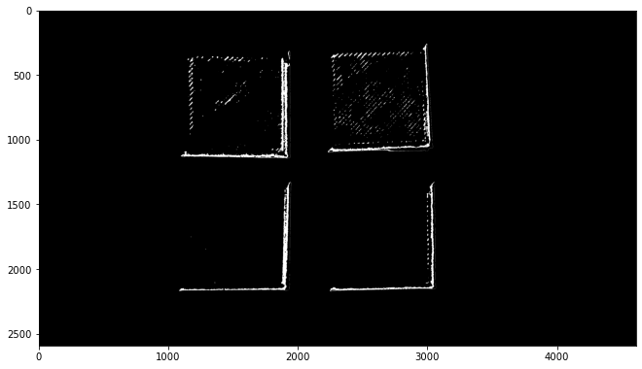
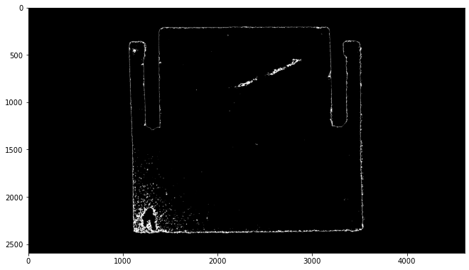
Result
Triggers on “blobs”
Also triggers on edges
The thresholding makes an edge detector
Could be improved with edge removal and ROI
Tells users to clean their nozzle when triggered
Custom threshold results

Slide 10
Finding Elephant’s foot
Background: if the nozzle is too close to the print bed, filament will be squished when extruded.
Split the image into top and bottom halves
Calculate the line of the profile
Find large deviations near the bottom of the object

Slide 11
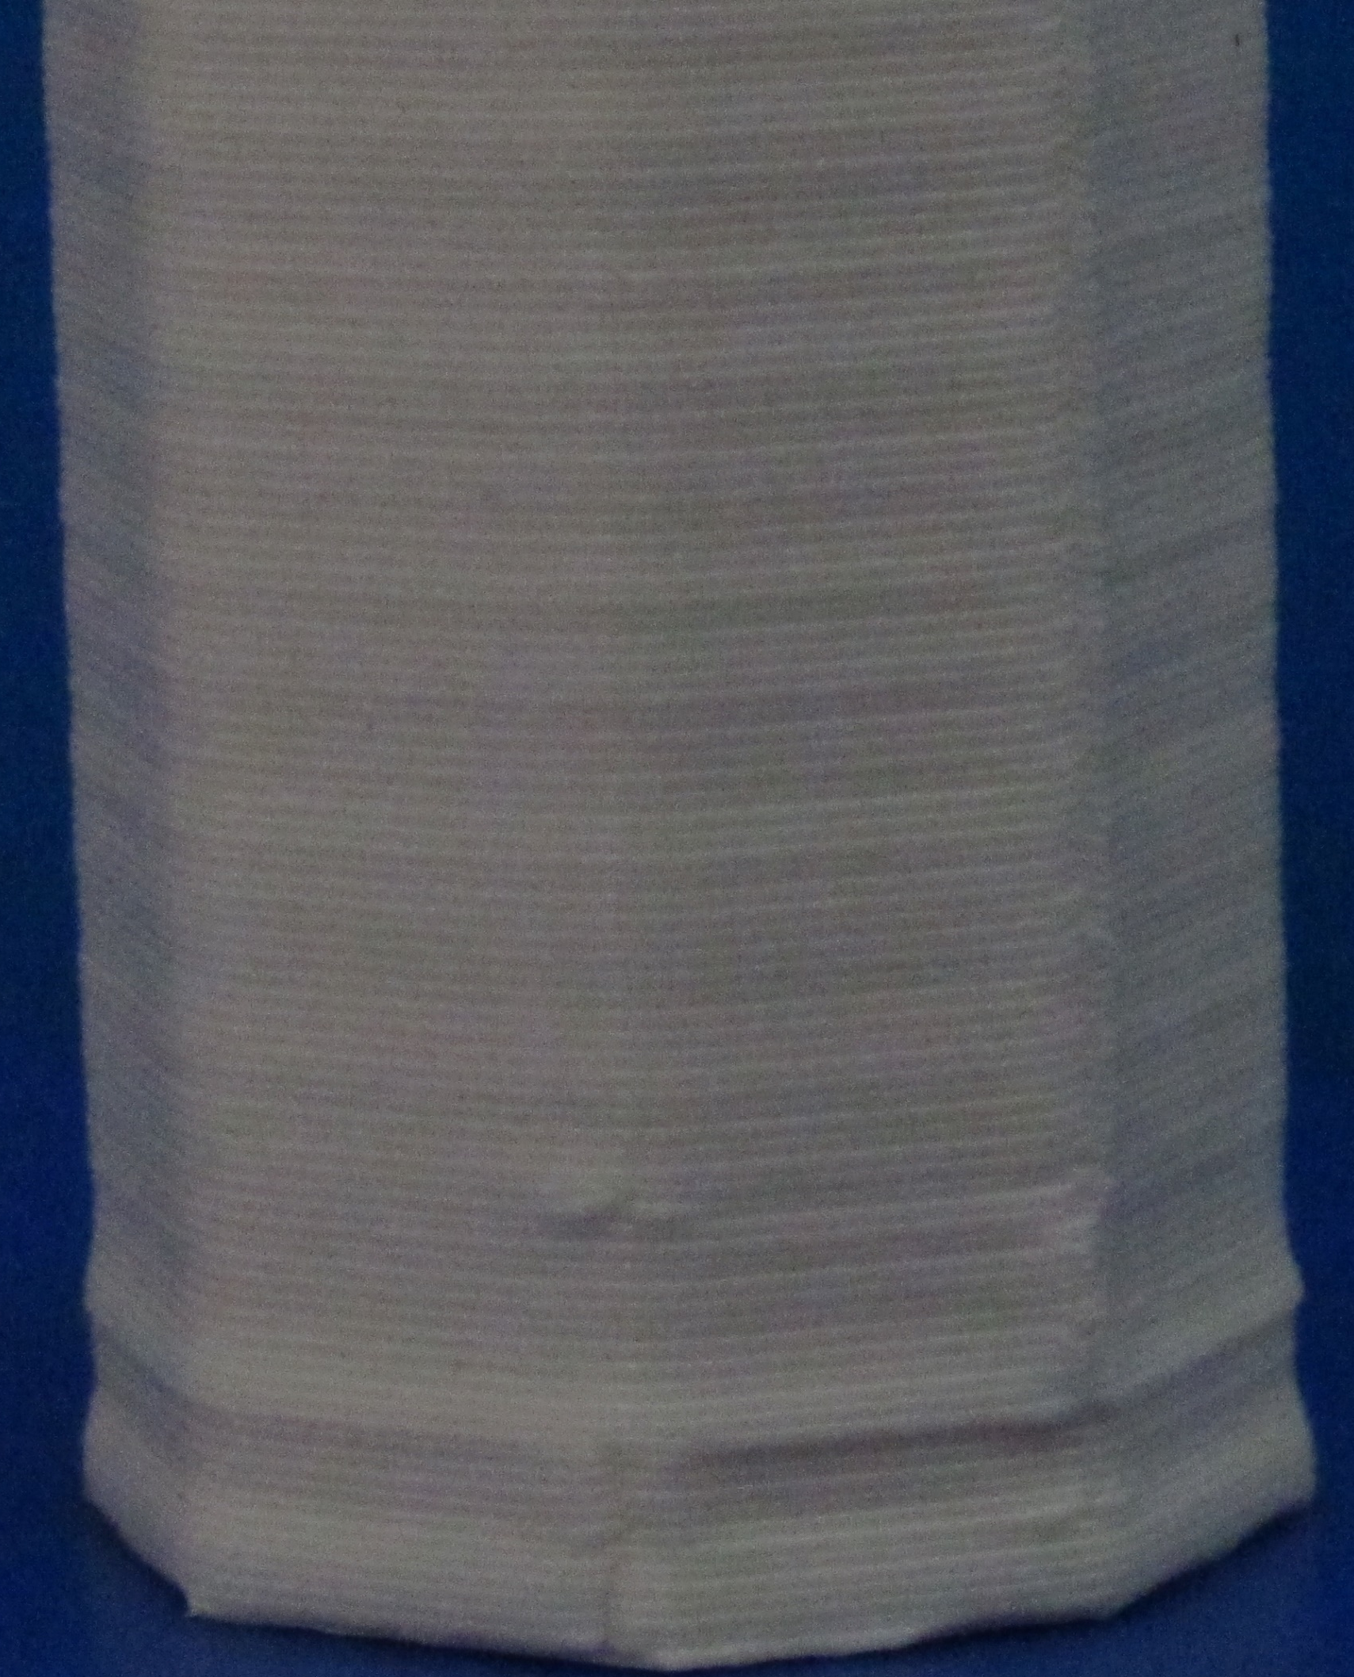
Example
Find the line made by the walls on the top half
In the bottom half, find the end
Look for large deviations
Tell the user to re-level the print bed
Large
Deviation

Slide 12
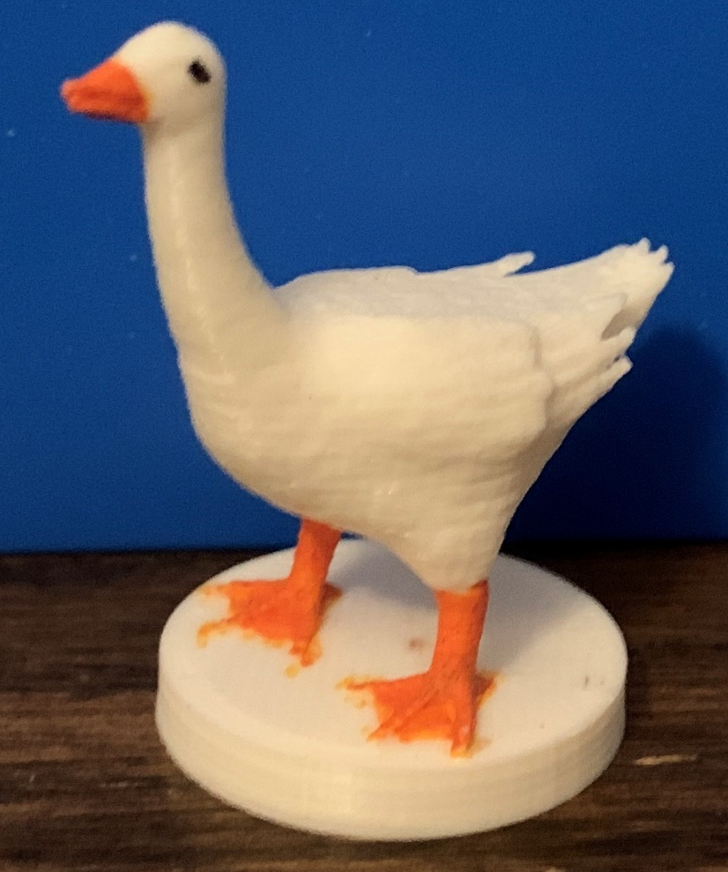
General Limitations
User cannot enter actual cube dimensions
Only works with lightly colored objects
Needs a dark background
Untested on complex objects
A “complex” object

Slide 13
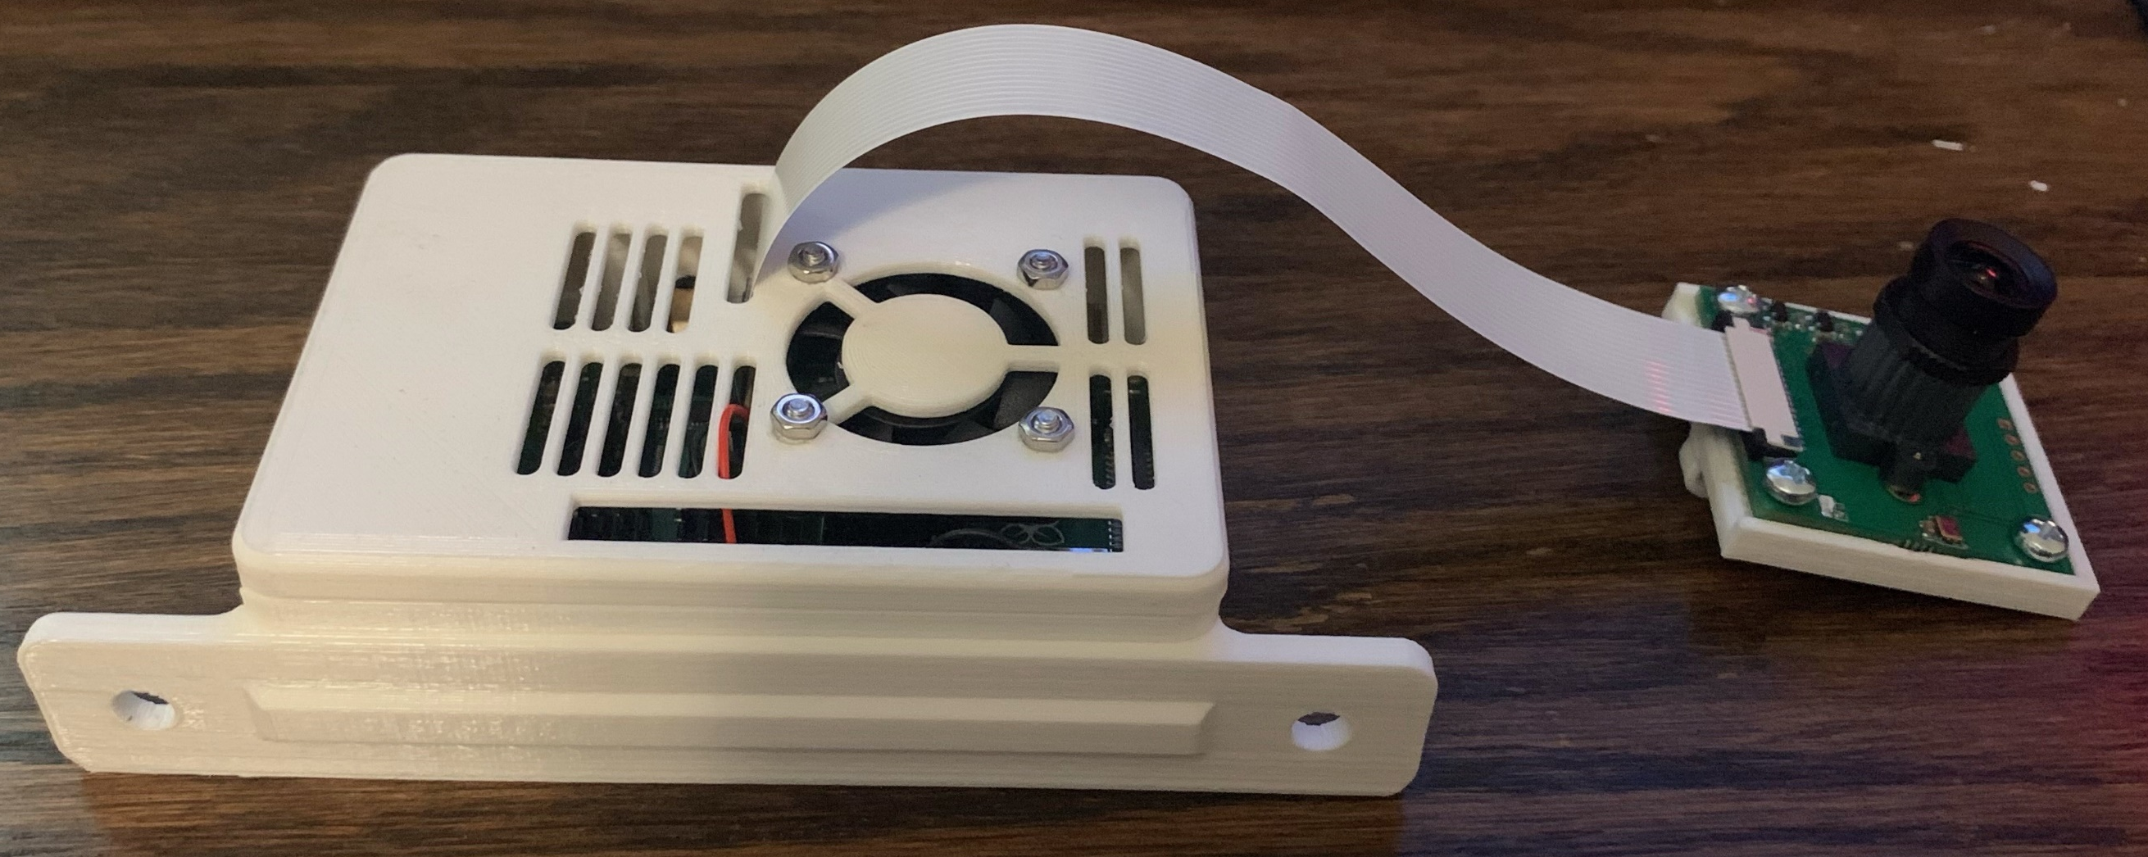
What next?
Implement elephant’s foot detection
Extras
Put program on Raspberry Pi
Process quality while printing
Create time lapses
Estimate PID loop accuracy
Raspberry Pi setup to take pictures while printing

Slide 14
Questions?

Slide 15
References
OpenCV contour guide: https://www.pyimagesearch.com/2016/10/31/detecting-multiple-bright-spots-in-an-image-with-python-and-opencv/
All photos are taken by myself

